Slide 1
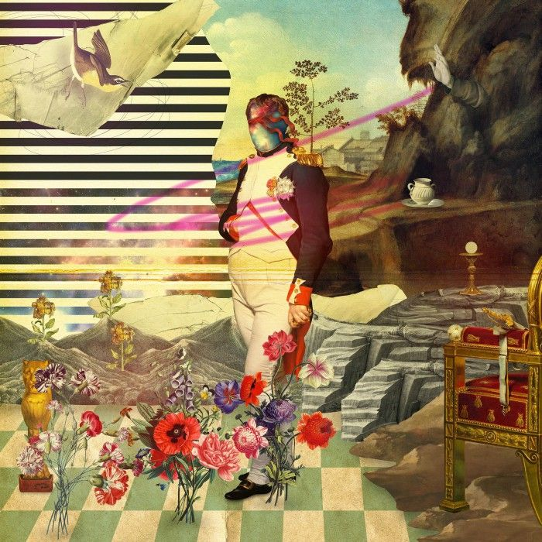
Collage Art
This art form has a lot of variations and in the following slides you will find examples of different techniques and approaches that artists have used to make collages . I hope these examples can help to inspire what techniques you will use on your collage magnets .

Slide 2
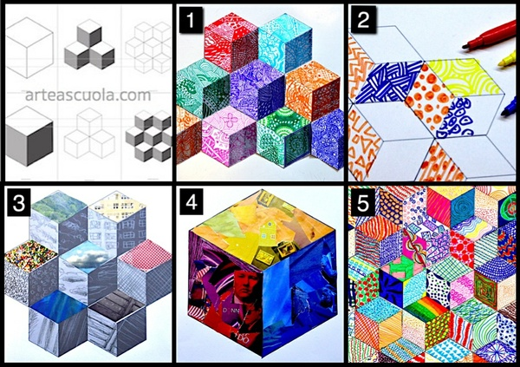
Geometric
Use the different papers as the design for a geometric pattern I helps to cut out templates to use while you gather images so that each is easily traced and cut to the desired size before gluing

Slide 3
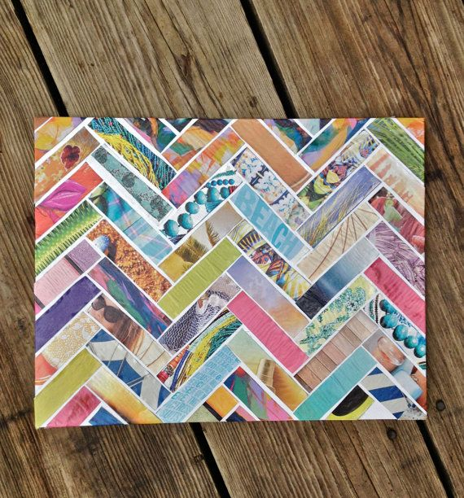
Geometric

Slide 4
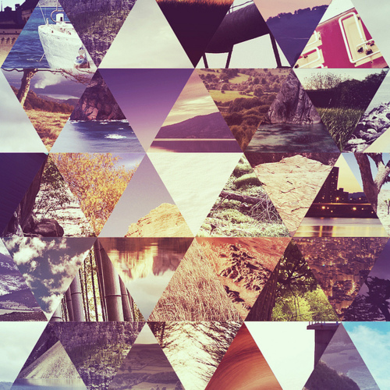
Geometric

Slide 5
Silhouette
Create a back ground and then cut and paste a silhouette on top . For a added change you can create the silhouette out of other small dark images as shown below.

Slide 6
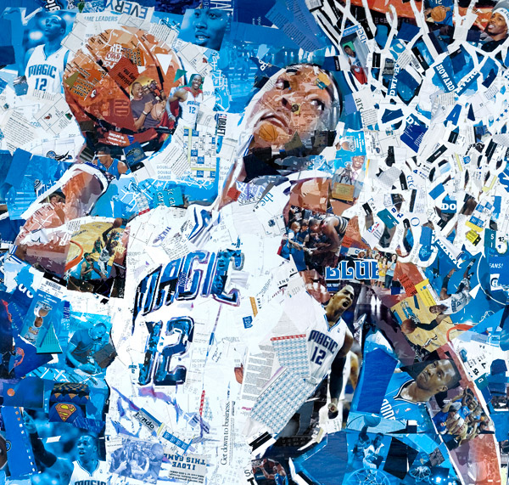
Picture in picture
This image is created by using other images . To do this you must first draw/map out the large image . Find a variety of smaller images and separate them by color . Then apply smaller images in a color by number fashion to create the larger image.

Slide 7
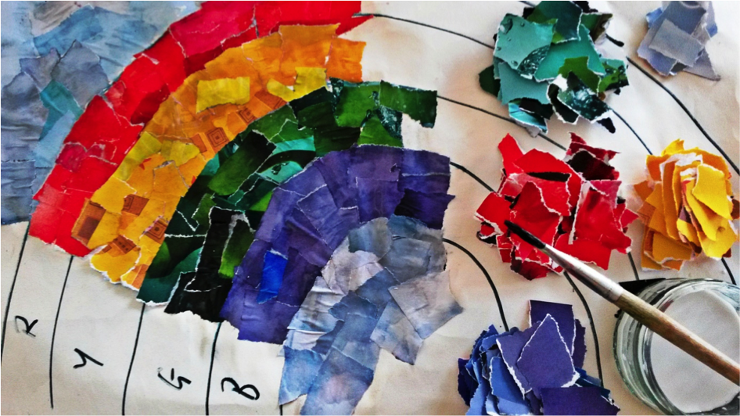
Picture in picture
This is an example of a picture in picture being completed . As you can see you can also focus on using just scraps of different colored papers to create this fragmented look .

Slide 8
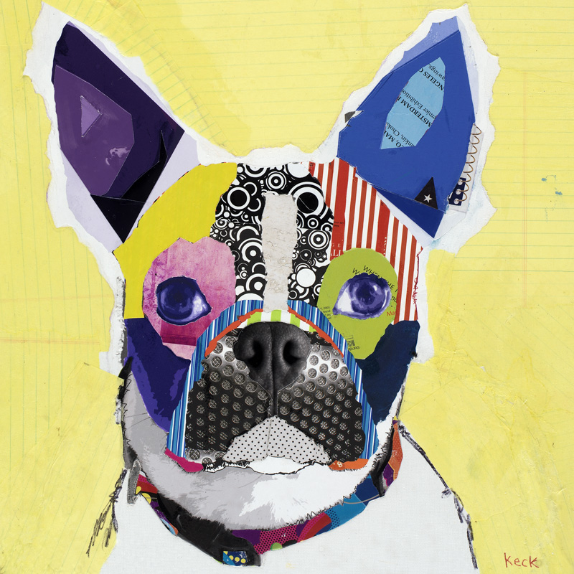
Picture in picture

Slide 9
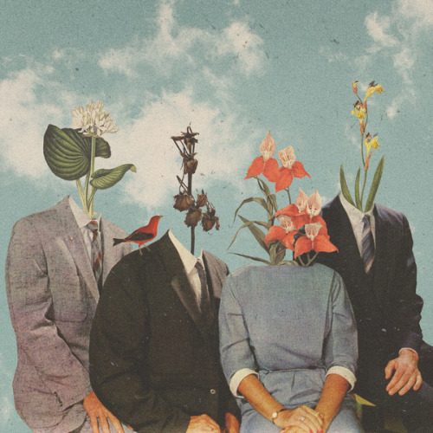
Replacement
Replace a part of an image with another image

Slide 10
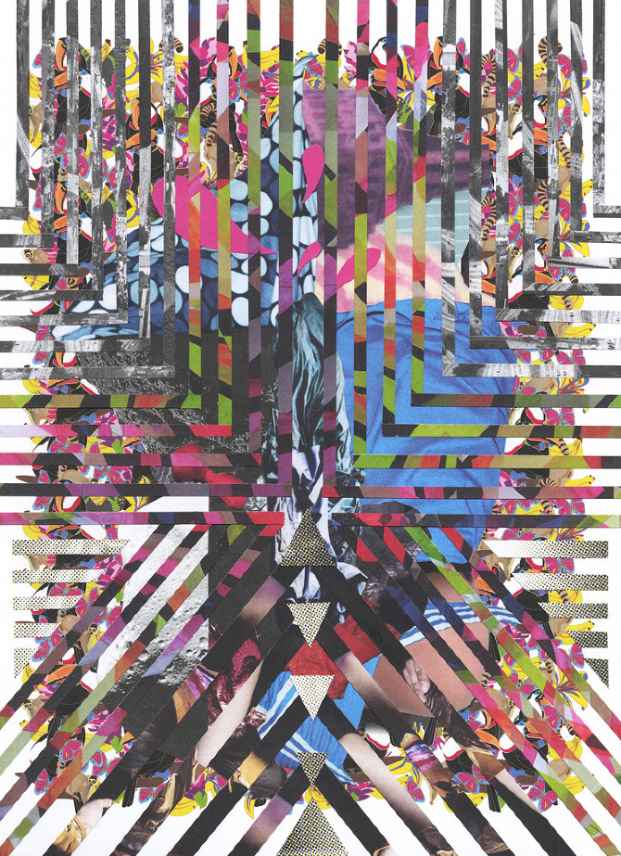
Geometric layering
Cutting and layering images to view only portions of an image

Slide 11
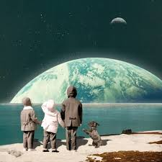
Overlapping
Adding new items to the picture by overlapping them in the scene.

Slide 12
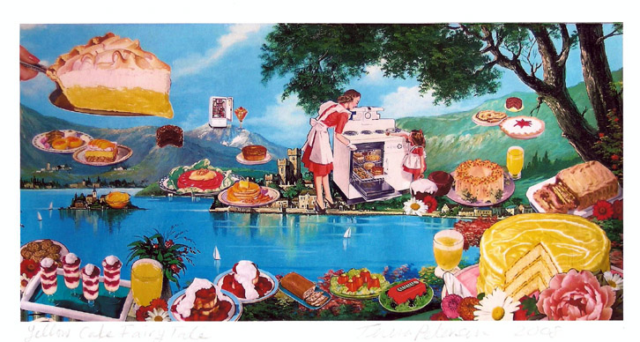
Overlapping
This can make for some very surreal images .

Slide 13
Overlapping

Slide 14
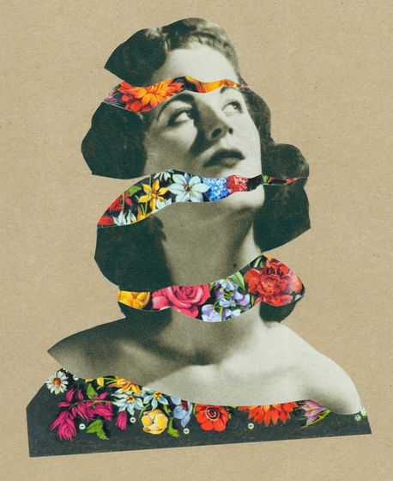
Peekaboo layers
Cutting and layering in a way that shows layers underneath .

Slide 15
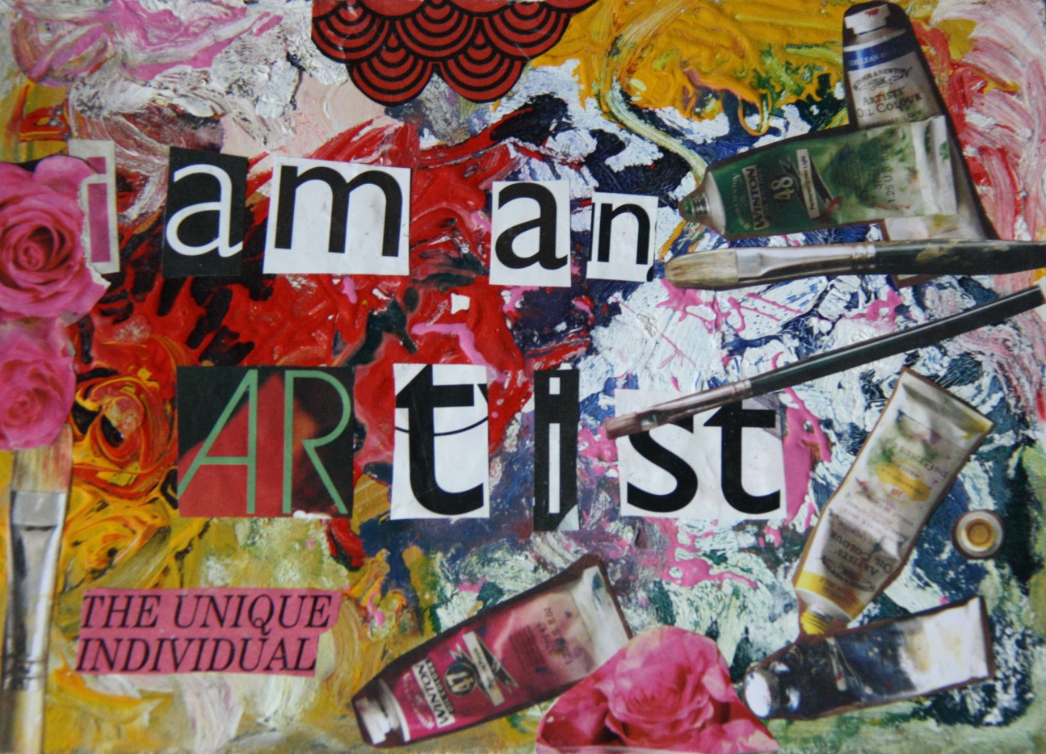
Overlapping edges
Images run one into the other overlapping to fill the picture frame .

Slide 16
Your magnet requirements
Neat, cuts are made with care, extra space is removed from desired images , glue is used sparingly ..etc.
The magnet has a theme . Students must be able to explain the theme they have selected and why they picked it once their magnet is completes. (no random mash ups for no reason)
Must use all the space on the magnet (cover the whole background )
Use one or more of the described techniques . Students at a minimum must over lap images on their magnet in a thoughtful and interactive way.
You may use the following materials on this project . magazines ,scrap paper ,your drawings, maps, newspaper, custom dyed/marbled papers, color pencil, sharpie, pen, paint by personal request (must have idea approved) if I do not have a supply that you want, for example a personal photograph or a magazine image that you have at home and want to use please feel free to bring those materials in .

