Slide 1
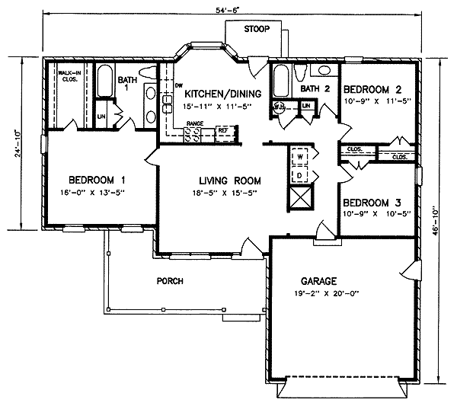
Examples of floor plans /blue prints

Slide 3
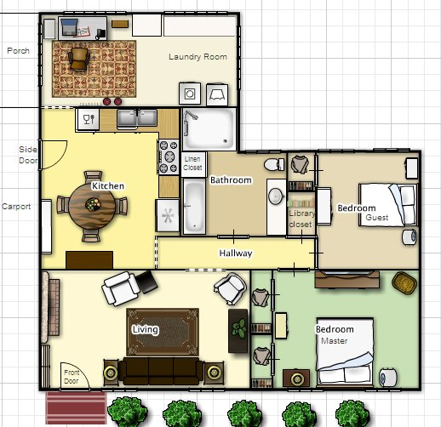

Slide 4
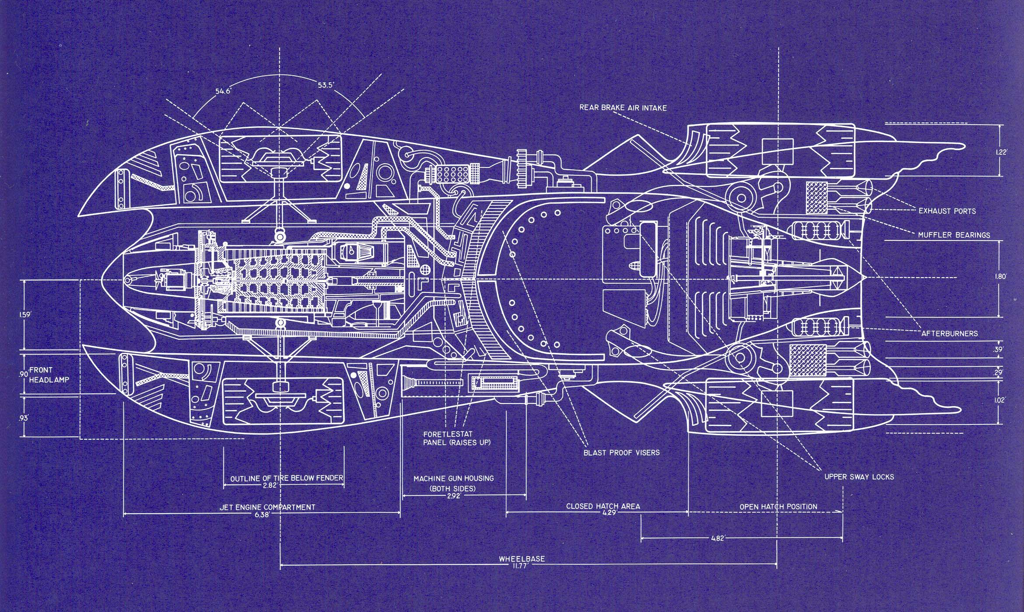

Slide 5
Things to make your floor plan successful
Neat Lines
Clear Labels
Simply Symbols
Key if necessary
One floor per page
Keep scale in mind

